Slide 1
Navigating the Academic Job Market
Courtney Hillebrecht, Ph.D.
Assistant Professor
Department of Political Science
University of Nebraska-Lincoln

Slide 2
Outline
Timeline
Preparing Your Packet
APSA Interviews
Job Talks
On Campus Interviews

Slide 3
Timeline, Part 1 (Market Prep)
Winter:
  Talk with advisor: Are you ready to go on the market next year? Can you defend the following spring?
  Attend ISA/MPSA: network.
Spring/Summer:
  Get personal website up.
  Prepare packet materials (see “The Packet”).
  Ask letter writers.
  Get official transcripts (late summer).

Slide 4
Timeline, Part 1 Cont. (Market Prep)
August:
  Submit materials for APSA interviews; contact schools for APSA interviews.
  Practice elevator pitch.
  Have advisor and colleagues look over packet materials.
  Start identifying jobs through ejobs (APSA website).

Slide 5
Timeline, Part 2 (On the Market)
September:
  Attend APSA for interviews and networking, including presenting your own work.
  Put finishing touches on packet. Start sending them out.
Fall:
  Continue identifying jobs and sending out packets.
    Identify early deadline post-docs.
  Continue writing your dissertation.
  Develop and practice job talk.
  Phone and on-campus interviews.

Slide 6
Timeline, Part 3 (Still on the Market)
Winter:
  Continue with everything under “Fall.”
  Look seriously at visiting positions and post-docs.
  No matter what, keep writing your dissertation.
Spring:
  Evaluate options.
  Write, write, write.
  DEFEND!

Slide 7
The Packet: Components*
Cover Letter
C.V.
Research Statement
Teaching Statement and Evaluations
Writing Sample(s)
Sample Syllabi
*Be sure to follow exact instructions on what to include in your packet.

Slide 8
The Packet: Cover Letter
Tailor to each department but don’t reinvent the wheel.
Basic components:
  Explanation of how you would meet the department’s needs (see their ad). Be very clear about this!
  Sections on research/teaching.
    Prioritize the section most appropriate for the school.
  Contact information.

Slide 9
Your C.V.
Main Sections:
  Education
  Research
    Dissertation: BRIEF summary (1 para max)
    Publications
    Under review
    Conference papers
  Teaching Experience
  Languages, skills, etc.
  References

Slide 10
The Packet: Research Statement
Research Statement Components:
  Explain dissertation and related publications (or publication plans).
  Stand-alones
  Next project: research, contribution and publication plans.
Be sure to identify your contributions and your identity as a researcher.
Re-articulate research trajectory outlined in letter and c.v.

Slide 11
The Packet: Teaching Statement
Teaching Statement Components
  Teaching philosophy
  Courses taught and courses you’d like to teach
  Course evaluations (qualitative and quantitative)

Slide 12
The Packet: Writing Samples
Generally: two chapters of your dissertation and one stand-alone piece.
  From the dissertation: One theory chapter, one empirical.
Evolving trend: one “job market paper.”
Tips:
  Use samples to showcase methodological breadth.
  But...better to have polished samples.
  Explain these samples in cover letter.

Slide 13
Examples...
Good idea to collect examples of successful packets.

Slide 14
The Big Leagues: Interviewing

Slide 15
APSA Interviews: The Good and Bad
The Good:
  Might lead to an on-campus interview.
  Opportunity to take your pitch on a test run.
  Networking.
The Bad:
  The setting: like the waiting room at your doctor’s.
  Not all schools interview.
  Time and mental/emotional energy.

Slide 16
APSA Interviews: Rule of Thumb
Talk with schools from whom you’d consider an offer. Keep an open mind.
But don’t use APSA interviews just for practice. Wastes your time and theirs. A true lack of interest is apparent, and you don’t know who they know.

Slide 17
On-Campus Interviews: Overview
Generally scheduled by department coordinator.
  1-2 days of meetings/meals/job talks.
  Be sure to schedule bathroom and water breaks, but don’t plan on them.
    Nursing moms: be clear about your needs if you’re pumping.
Most schools bring in 3-5 candidates.
Two-way interview: they evaluate you and you evaluate them.
Personal life should be off the table, but might come up. Don’t be a robot in case it does.

Slide 18
Job Talks: The Basics
Approx. 40-min. talk about your research.
Audience = Generally covers spectrum of political science (and beyond).
  You’re likely the only one in your room that knows anything about your topic.
Followed by Q & A.

Slide 19
Job Talk: Preparation
Watch Professor Patrick Winston’s (MIT) (in)famous “how to give a talk talk”:
  http://www.youtube.com/view_play_list?p=9F536001A3C605FC
Outline ideas and identify (clearly):
  Hook
  Argument
  Contribution
  Future plans.
Practice, practice, practice.

Slide 20
Job Talk: Best Practices
Be clear about your question and contribution.
  Where do you fit in? What literature(s) are your speaking to?
  What does your dissertation add? How does it move the field forward?
Have 1 or 2 slides that show your argument/contribution.
Data and methods: remember, audience of “generalists.”
Remember the rule of 3: highlight main points at beginning, middle and end.

Slide 21
Job Talks: Stylistic Points
Take control of the room and present yourself as an equal.
  Try to leave lights on. Dark rooms make audiences sleepy.
  You are a colleague, not a student.
Answer interjections, but don’t let them get out of control.
In the Q&A, be polite but firm. Don’t be defensive. The audience wants to know how you think/process ideas.
Miscellaneous:
  Verbal ticks (“um”), pacing, drinking (use a cup/straw, not bottle/can), etc.

Slide 22
On Campus Interviews: Meals and Meetings
Hum the same tune the whole visit:
  What is your work about? What contributions does it make to the field?
Be professional and collegial. Will you fit into this department for the next 7+ years?
Standard list of questions you should be prepared to answer.
  See next slide.
Ask questions!
  See slide after next.

Slide 23
On-Campus Interviews: Questions to Expect
What is your dissertation about?
Where does your research fit in? Who are you?
What is you future research agenda?
What are your teaching interests? Where can you contribute?
How would you teach those classes?

Slide 24
On-Campus Interviews: Questions to Ask
About the individual’s research
About the department’s culture (but tread carefully)
About collaboration with other faculty and with students
About the students
About the university
About the city

Slide 25
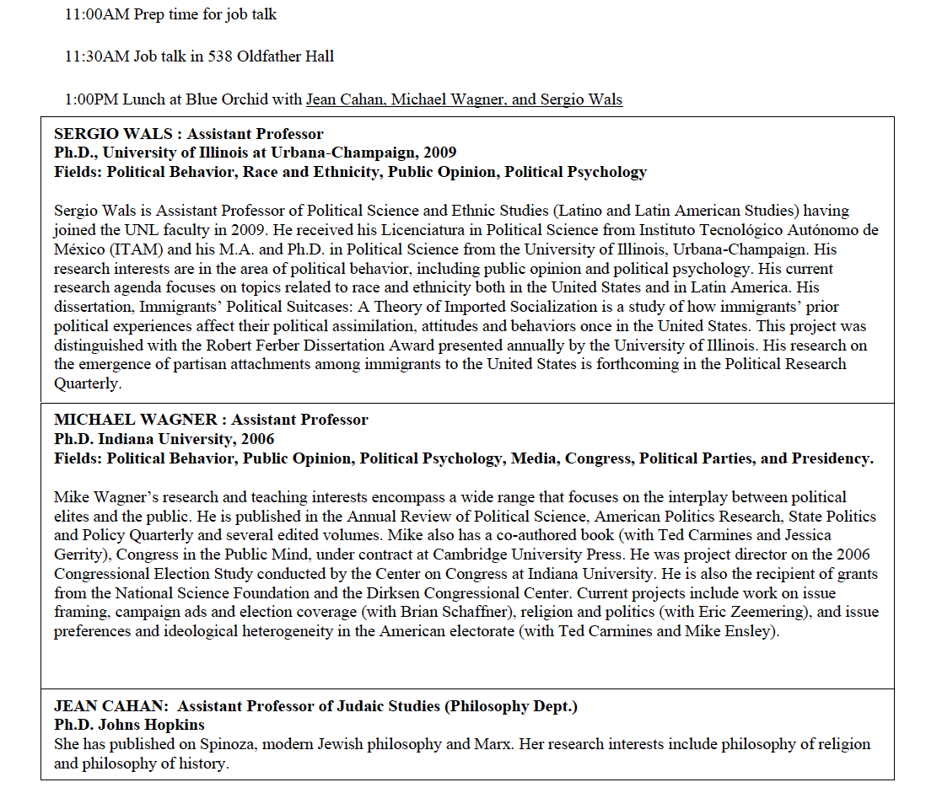
A Tip for Surviving the One-on-Ones: Your Interview Cheat Sheet

Slide 26
On-Campus Interviews: After the Offer
Salary and benefits.
Spousal/partner/family issues.
Reaffirm plans to complete and defend dissertation.

Slide 27
On the job market, do this, not that:
Be confident not conceited.
Act like a professor not a student.
Develop bullet-proof skin, and don’t be defensive or overly sensitive.
Treat the job market like a business transaction not a pseudo-intellectual quest.
Remember that committees are looking for reasons to reject you and will not look past gaps in your CV, mistakes in your materials or a poor fit.

Slide 28
Good luck!

